Slide 1
ASMS Sanibel 2018
Molecular Dynamics/Kinetic Theory Algorithm for Numerical Determination of Electrical Mobility
Carlos Larriba Andaluz
ASMS Sanibel Conference, January 28th 2018
St. Petersburg, FL

Slide 2
Ion Mobility: Which One is Optimal
Ion Mobility: Which is Optimal?
It depends on what you are interested in.

Slide 3
MDKTG: Limitations
Limitations of CCS Programs
Fixed atom positions will never provide true reemission laws. Upon collisions, energy exchange exists between degrees of freedom that is not accounted for. This might lead to diffuse inelastic collisions (EHSS does not work for heavier gases).
Different gases behave differently upon collision so parameters need to be determined experimentally for each atom and each gas.
Mobile structures may be constantly varying in the gas phase and are not static. This requires multiple structures to achieve highly accurate CCS.
There might be preferred orientations or higher order potential interactions not accounted for.
The velocity of the ion is considered to be much smaller than the gas velocity, and is assumed constant
All such limitations require experimentally obtained Lennard Jones parameters that can take care of the diffuse effect of the collisions.

Slide 4
Despite these limitations, TM CCS are normally very accurate

Slide 5
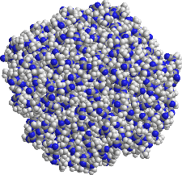
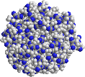
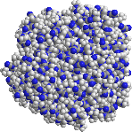



Calculation Methods with Energy Accom.: N2 vs. He
Larriba et al., PCCP 2015
Courtesy of Juan Fernández García, Yale University
Nitrogen vs. He contour plots. Raw data.
One can rearrange the two plots using the experimental CCS and PA (from mass and density).

Slide 6
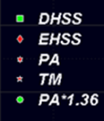

EMINCN2 All Results
Collision Cross Sections are strikingly different depending on the gas!!
TM LJN2
Diff TM
DHSS
EHSS
PA
TM
PA*1.36
TM LJN2
TMLJ He
Will reach 1.36 at around 240000 atoms ~ 3MDa
240MDa
TM LJHe
Larriba et al., PCCP 2015

Slide 7
COUPLING IMoS to Molecular Dynamics

Slide 8
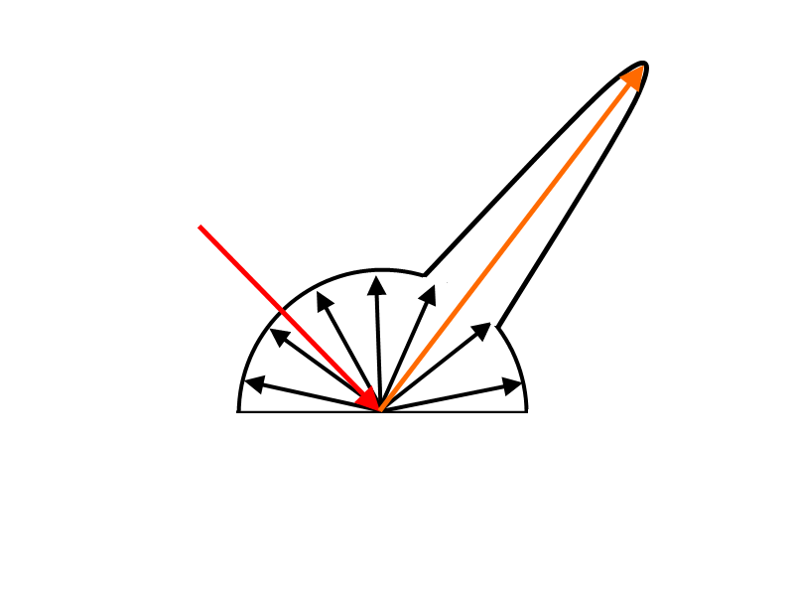
MDKTG: IMoS coupled to TINKER
SUGGESTED APPROACH:
Couple MD TINKER software package with IMoS: MDKTG.
Any Molecular Dynamics Package can be used in principle:
    MM2 MM3 MMFF
    AMBER AMOEBA
IMoS executes the molecular dynamics package within and adds a Gas Molecule velocity and position sampled from a skewed Boltzmann distribution. Collects velocities and positions of Gas far away from ion.
Although the ion travels at velocity V, the system is centered on the ion and Gas molecules have relative velocities V+c and V-c.
After every collision, energy is transferred between ion and gas molecules. In order to make every gas molecule-ion collision independent, energy conservation is assumed for the gas molecule (to improve convergence and avoid loss of energy).
He/N₂

Slide 9
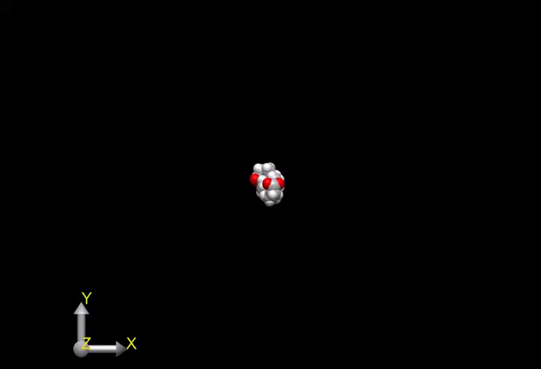
MDKTG: He results.
Calculations with He
Conditions:
Time step 0.1 femptoseconds
About 0.1-1ps calculations for every gas molecule.
For 10⁶ gas molecules, one simulation requires 0.1μs of total MD time.
Each Gas Collision is independent of each other.
No ion-induced dipole potential.
Outcomes for He:
Gas molecule impingement barely affects structure: Collision can be thought of elastic specular.
Calculations become quite long.
Small mass barely affects larger heavy atoms.
Calculated CCS after 90000 gas molecules is 103.2 A² vs 111.3 A² for TMLJ.

Slide 10
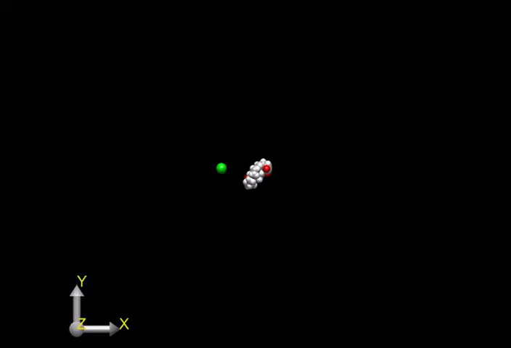
MDKTG: N2 results.
Calculations with N₂
Conditions:
Time Step: 0.5 femptoseconds
N₂ is in this case simplified as a single atom of mass 28Da.
The vdw parameters used for the He atom are
σ = 1.99A and ε = .268kcal/mol
No ion induced dipole was added to the calculations.
Outcomes for N₂
Gas molecule impingement greatly affects ion deforming it. Collision can be regarded as diffuse (“Accomodated”).
Larger mass of gas molecule is a key factor in this type of collisions.
Calculated CCS after 90000 gas molecules is 174.8 A² vs 165.48 A² for TMLJ.

Slide 11
MDKTG: Pre-calculated Positions and velocities: Results in He.
C540
Azulene
Dibenzopyrenes
Pyrene
Results with He and Comparison to TMLJ (no ion-induced dipole)
Results obtained are within 10% up to 1000 atoms.

Slide 12
MDKTG: Pre-calculated Positions and velocities: Results in N₂.
Phenylnaphthylamine
TMA
Pentacene
Benzo-c-fluorene
N2 also predicts collision cross sections within reasonable accuracy when compared with TMLJ.
This is without LJ parameters or assumptions of reemissions! (No Ion Induced Dipole Potential)

Slide 13
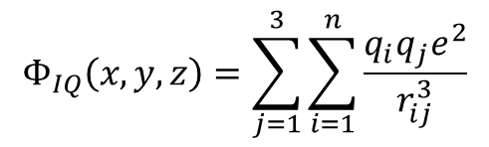
MDKTG: Optimization
If diffuse collision exchanges can be embedded into L-J potentials, an effect such as the ion-quadrupole for N₂ can most likely be embedded into the L-J parameters as well.
Can we optimize the L-J parameters easily?
The quadrupole moment is obtained by placing one negative charge of 0.4825e on each nitrogen and one positive charge of 0.965e in the center of the molecule.
In such a way, the ion quadrupole potential can be expressed as:
$$Φ_{IQ}\left(x,y,z\right)=\sum_{j=1}^{3}{\sum_{i=1}^{n}{\frac{q_{i}q_{j}e^{2}}{r_{ij}^{3}}}}$$
j denotes 3 different N₂ charges (2 being the center charge) and index i indicates the charges on the ion/atoms

Slide 14
Optimization of L-J Potentials in N₂ (no ion-quad)

Slide 15

MDKTG: Pre-calculated Positions and velocities: Results in N₂.
A quadratic function is used to minimize the difference between calculated and experimental CCSs:
The target is to find the minimum value for the function (gradient descent), where the gradient will become zero:
16 candidate structures were taken from DFT calculations with experimental results taken from Campuzano et al. 2012 Anal Chem.
Elements appearing are C,H, O, N and F. We have 16 structures and 10 unknowns, so the system should be overdetermined.
$$∇𝓕=0$$

Slide 16
MDKTG: Pre-calculated Positions and velocities: Results in N₂.
It Didn’t Work?!!
It gave different results depending on your initial guesses.

Slide 17
Optimization of L-J potentials
A ceteris paribus technique was employed instead.
The ceteris paribus (All other equal) technique consists on optimizing one element at a time leaving the other constant in sequence and iterate.
Allows for a surface mapping technique.
More than 10,000 CCS in N2 go to the calculation of this surface!
Not a unique minimum!!!
Tianyang et al.,The J of Physical Chemistry 2018 (accepted)

Slide 18
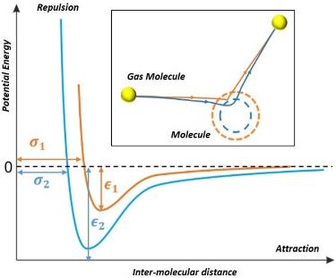
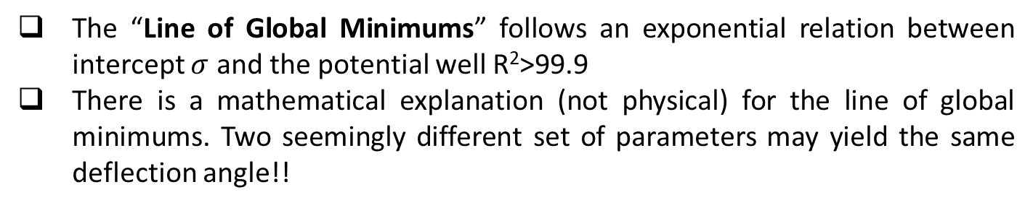
Optimization of L-J potentials
The “Line of Global Minimums” follows an exponential relation between intercept $σ$ and the potential well R²>99.9
There is a mathematical explanation (not physical) for the line of global minimums. Two seemingly different set of parameters may yield the same deflection angle!!

Slide 19
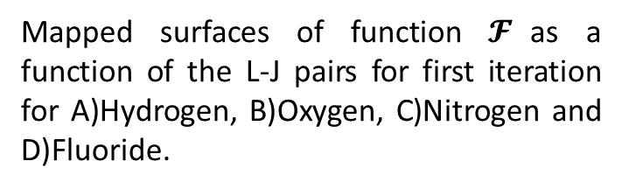
Optimization of L-J potentials
Similar results for the rest of the Elements. Although some exhibit more of an apparent minimum.
The less abundant the element (or the less it contributes to the CCS), the larger the uncertainty.
Mapped surfaces of function $𝓕$as a function of the L-J pairs for first iteration for A)Hydrogen, B)Oxygen, C)Nitrogen and D)Fluoride.

Slide 20
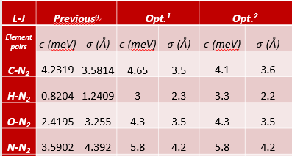
Optimization of L-J potentials
After several iterations, solution converges.
The solution still varies depending on our choice for the L-J pair out of the global minimum.

Slide 21
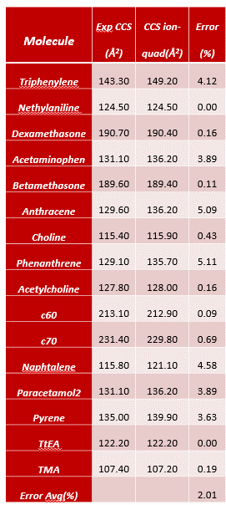
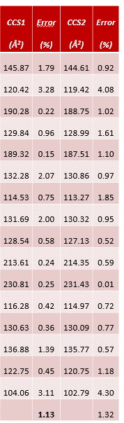
Optimization of L-J potentials
When comparing results
Results from Campuzano et al Anal Chem 2012 using ion quadrupole potential.
Similar agreement than ion-induced quadrupole.
Method can be used to Optimize L-J parameters in other gases!

Slide 22
Optimization of L-J potentials
However…

Slide 23
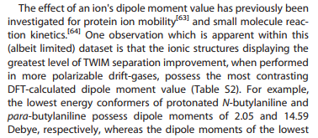
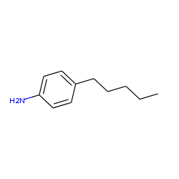
Optimization of L-J potentials
 | Ω-N2 | SD | CCS-IMoS-N2 | SD | Error | Dipole Moment
Leucine | 140.3 | 0.9 | 124.7 | 1.3 | -12.6 | 6.45
Isoleucine | 137.2 | 1.0 | 123.7 | 1.1 | -10.9 | 6
N-ethylaniline | 131.3 | 1.5 | 122.8 | 0.5 | -6.9 | 4.92
N-propylaniline | 136.8 | 1.5 | 127.9 | 1.0 | -7.0 | 2.68
N-butylaniline | 141.9 | 1.0 | 134.7 | 1.4 | -5.3 | 2.14
N-pentylaniline | 147.1 | 0.8 | 140.9 | 2.3 | -4.4 | 3.78
4-ethylaniline | 141.1 | 0.7 | 124.0 | 0.9 | -13.8 | 10.45
4-propylaniline | 148.7 | 0.8 | 131.0 | 0.6 | -13.6 | 11.76
4-butylaniline | 154.3 | 1.1 | 138.1 | 1.5 | -11.7 | 13.33
4-pentylaniline | 164.3 | 0.7 | 145.3 | 1.5 | -13.1 | 16.37
Priscilla et al. 2013 (Journal of Mass Spectrometry)
Perhaps long range interactions together with preferred orientations (coming from permanent dipoles) are causing the difference!!
4-Pentylaniline

Slide 24
Optimization of L-J potentials
Sneak Peak into
IMoS 2.0

Slide 25
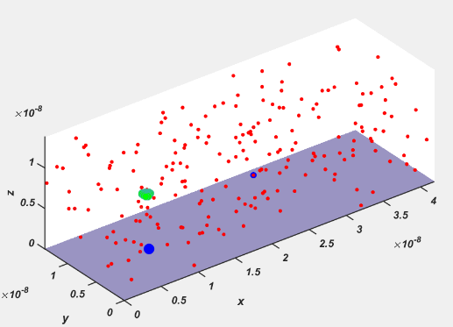
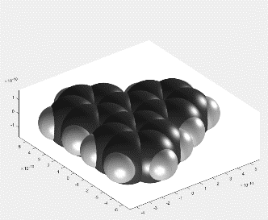

$$\vec{E}$$
IMoS 2.0
Buffer Gas
Ion Rotation
Electric Field
Non-uniform Velocity

Slide 26
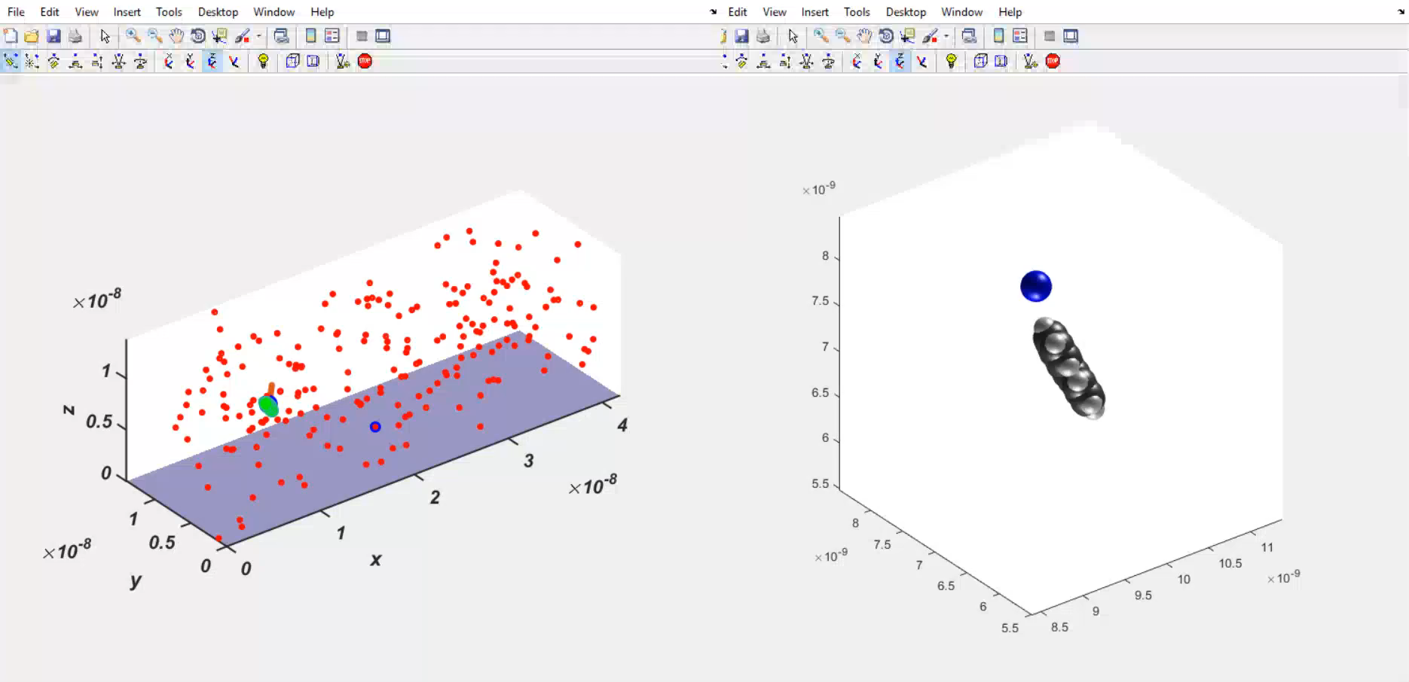
IMoS 2.0 VIDEO

Slide 27
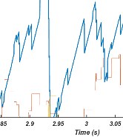

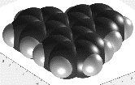



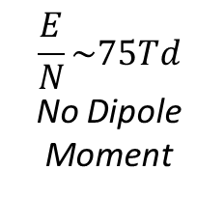
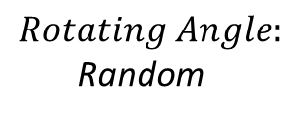
IMoS 2.0 Results
$$Triphenylene$$
$$\frac{E}{N}\sim 75Td$$
No Dipole Moment
$$v_{drift}\sim KE→K=\frac{v_{drift}}{E}→$$
$$CCS=120A^{2} (No ion−induced dipole)$$
$$Rotating Angle:$$
Random

Slide 28

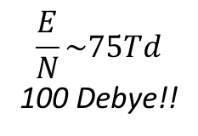
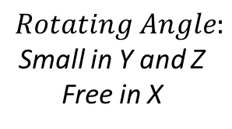
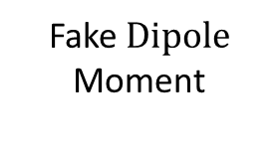

IMoS 2.0 Results
Fake $Dipole$
Moment
$$Triphenylene$$
$$\frac{E}{N}\sim 75Td$$
100 Debye!!
$$Rotating Angle:$$
Small in Y and Z Free in X

Slide 29
Conclusions
Conclusions:
Ion Mobility algorithms have their limitations
Despite their limitations, they can yield very accurate results (within a few percent)
Atoms are vibrating and add diffuse scattering as well as energy accommodation to the system leading toward enhanced drag collision cross sections. This has been verified by coupling IMoS with TINKER.
These effects can be added to L-J parameters without loss of accuracy.
Other effects can be embedded to the L-J parameters if they are correctly optimized. A New optimization method is proposed for N2 and may be used for other gases.
Orientational effects cannot be embedded into the L-J parameters. A new algorithm that takes into account possible effects of strong dipole moments and high E/N is proposed. To have a single preferred orientation, 100 Debyes at high E/N is needed.

Slide 30
Calculation Methods with Energy Accom.: Thanks
THANK YOU!
Questions??

