Slide 1
Modeling of Inverted Drift Tube Design for Classification of Sub-micrometric sized Particles at Atmospheric Pressure
Minal Nahin and Carlos Larriba Andaluz
October 19th 2016
A Kanomax Project

Slide 2
Introduction
Drift Tube requirements from Kanomax
Design Concept for the Inverted Drift Tube
Modeling of Drift Tube
Key Parameters
Stopping the ions
Arising Problems
New Strategies
“Intermittent Push” Flow
“Stopping Potential”
Instrument Characteristics
Resolution
Resolving power
Next Steps

Slide 3
Initial Model Design and Characteristics:
Fast Electrical Mobility Characterization System
Wide Range of Mobilities (Diameters) 0.3nm<D<100nm
Small device (<50cm)
Room Pressure
Can be coupled to a CPC (or an electrometer)
High Resolution (and resolving power)
Has to Compete against well established DMAs

Slide 4
Initial Concept of Inverted Drift Tube (Comparison to regular Drift Tube)
The Inverted Tube consists of two Forces: Electric Field and Drag Force.
The Electric Field is directly proportional to axial distance x but negative in direction.
There is a constant velocity flow, v_{gas}, in the axial direction.
At some point in the Drift Tube, the drift velocity, v_{drift}, will be equal to v_{gas}.
When this occurs, the particle is trapped inside the Inverted Drift Tube.
Field Strength
REGULAR DRIFT TUBE
INVERTED DRIFT TUBE
Lower Mobilities require Higher Fields!!!
Constant Electric Field pushes the ions through
Field Strength
Axial Distance
Axial Distance
v_{gas}
E
E
Gas
v_{drift} = ZE
Particles are stopped at some point in the Tube when:
v_{gas} = v_{drift} = ZE

Slide 5
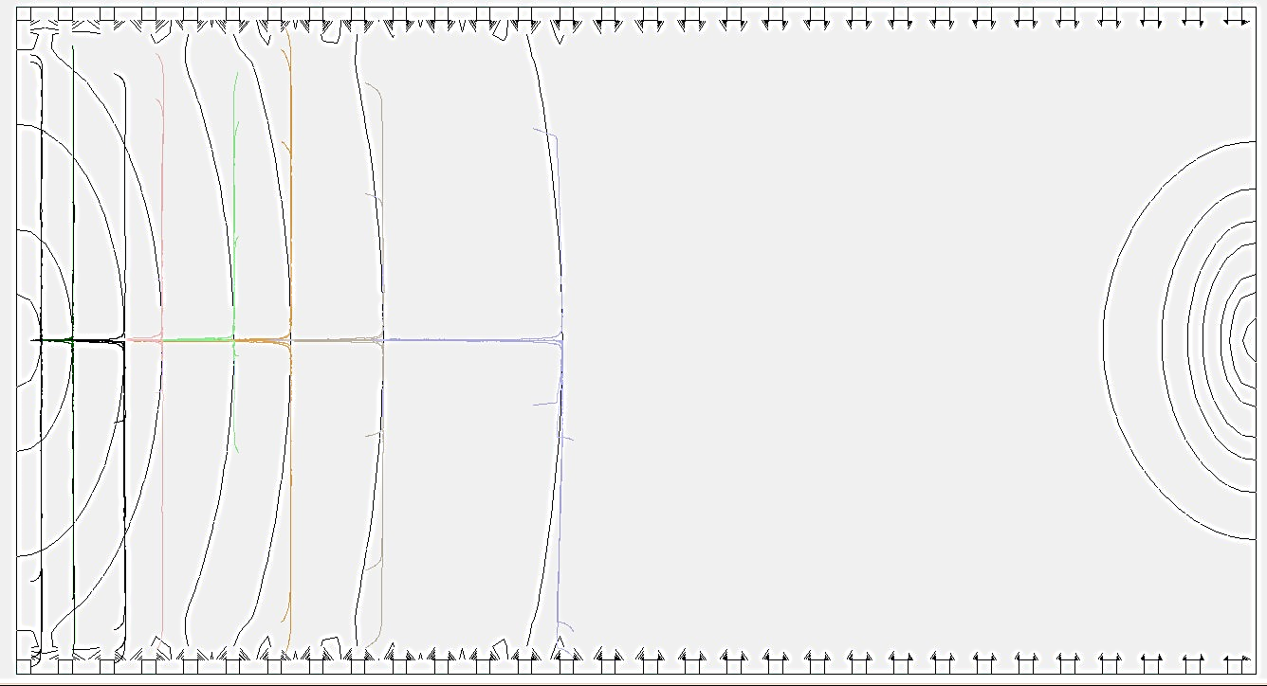
Nanoparticles of different Mobilities are stopped at their required Fields using SDS model.
Particles diameters shown range from 20 to 120 nm.
PROBLEMS THAT ARISE:
When nanoparticles are stopped, radial fields push nanoparticles to walls of the cylinder. As particles migrate to cylinder walls, they do not follow constant field lines, but constant E_{x} lines. Smaller Particles are lost before large are stopped.
Flow field, V_{gas}, is not uniform
How do we collect particles?
E
Constant Field Lines
E_{r2}>E_{r1}
v_{gas}
E_{x2}=E_{x1}
E_{r1}
E_{x1}

Slide 6
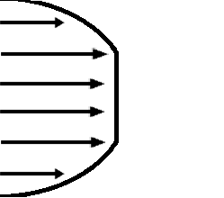
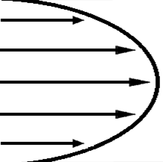
The flow field is not uniform due boundary layer formation inside IDT
The flow profile is parabolic
Particles of same mass over charge have different velocities
Big disadvantage for resolution
How can we maintain same velocity for same mass over charge particles ?
Particles are mostly at the center
keep the center velocity constant for a profile

Slide 7
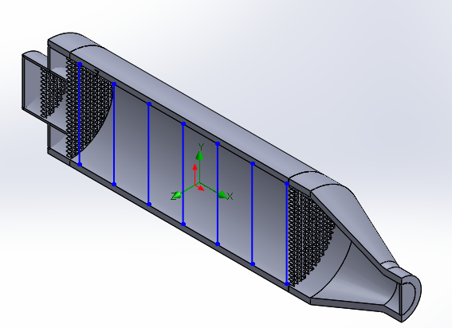
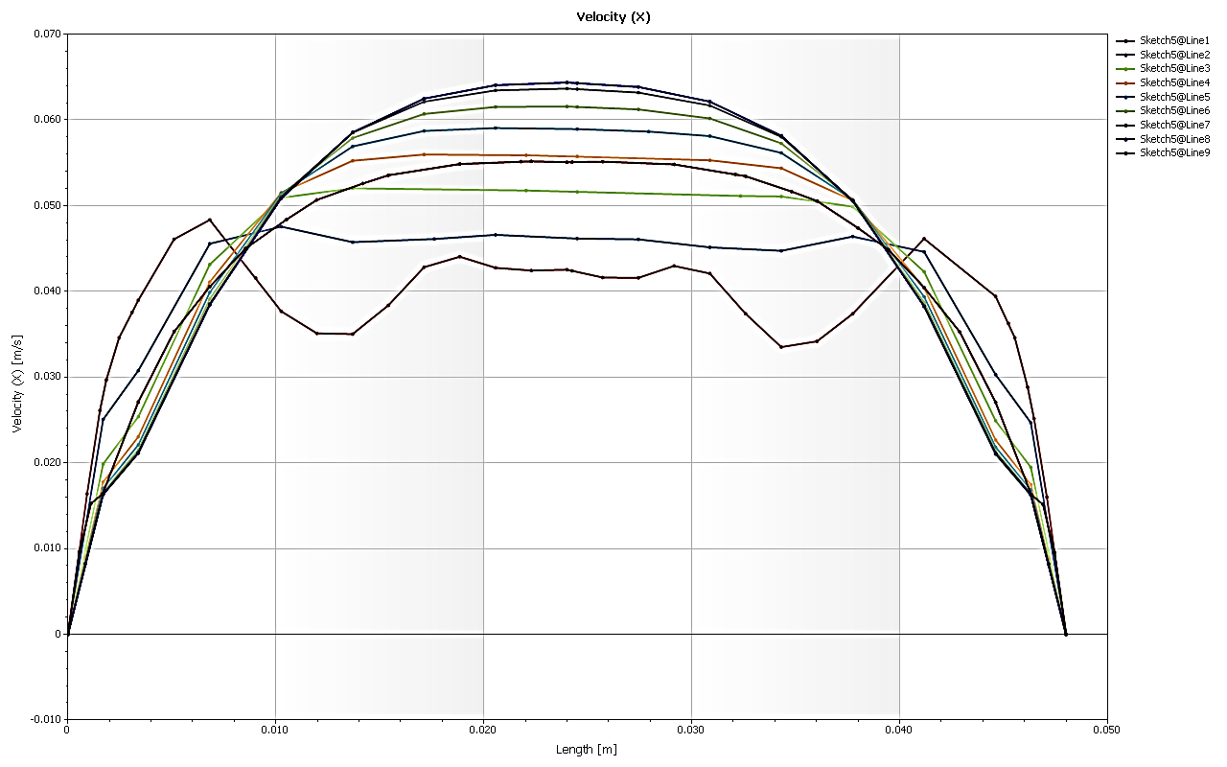
Increased the velocity
Introduced annulus flow
Introduced mesh at the inlet and out flow of IDT to make profile flat.
Flow profile from CFD simulation in steady state condition:
Flow
Profile corresponding to the blue lines shown in the CAD model

Slide 8
Method of Separation First Approach

Slide 9
First Approach: “Intermittent Push Flow”
Lower the field in subsequent pushes guiding particles through the drift tube
Field Strength
Field Strength,
Velocity
Velocity
At center
v_{gas}
Axial Distance

Slide 10
First Approach: “Intermittent Push Flow”.
Particles are modeled using Statistical Diffusion Simulations.
Arrival Times of Particles can be easily inferred Analytically.

Slide 11
First Approach: “Intermittent Push Flow”.
Resolution of particles as a function of arrival time distributions $\left(\frac{t_{MAX}}{Δt_{FWHM}}\right)$.
Arrival time distributions of sets of 100 particles are studied with Statistical Diffusion Simulations.
R~182
R~487
R~750
R~961

Slide 12
First Approach: “Intermittent Push Flow”.
Why do we have such a high resolution ?
Diffusion “Auto-Correction” as particles fly through drift tube.
Only when the Electric Field is set to low values, particles freely diffuse (very small relative times of diffusion compared to total flight time).
Resolution & resolving power can be enhanced by tuning intermittent pushes.
ZE>V_{gas}
Particle is pushed backwards
ZE<V_{gas}
Particle is pushed forward
Field Strength
ZE=V_{gas}
Stable
v_{gas}
Axial Distance

Slide 13
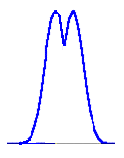
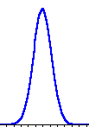
Resolution for two close particles might be very high (in our case for larger particles) but it might not be helpful for separation.
Also we can always tune electric field pushes to get high resolution for a specific particle size, so we cannot define an exclusive resolution. Is there a different easy to define resolution?
Define how well the peaks can be distinguished : resolving power!
_{W}
g_{HW}
If resolving power is zero then then there is no gap at the half width !
So, we conclude:
If resolving power > 0.2 peaks are separable
If resolving power < 0.2 peaks are not separable
$$Resolving power=\frac{gHW}{W}$$

Slide 14
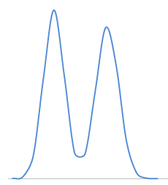
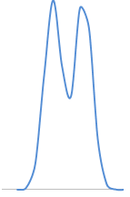
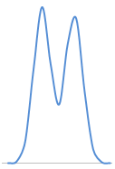
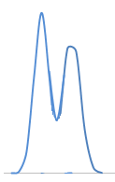
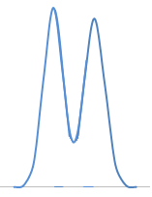
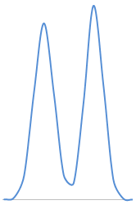
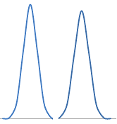
120.42 nm
114.07 nm
98.06 nm
95.57 nm
82.70 nm
80.61 nm
56.81 nm
55.89 nm
Ions are within 5.27 %
RP = 1.02
Ions are within 2.54 %
RP = 0.46
Ions are within 2.53 %
RP = 0.51
Ions are within 1.62 %
RP = 0.56
47.91 nm
47.14 nm
33.22 nm
32.69 nm
20.93 nm
20.59 nm
Ions are within 1.61 %
RP = 0.68
Masses are within 1.60%
RP = 1.16
Ions are within 1.62 %
RP = 1.42
Separation of very close masses is possible if the masses are small (diameter small)
Resolving power is inversely proportional to diameter or mass

Slide 15
First Approach: “Intermittent Push Flow”.
Consider the resolution of DMA is 10
Inverter Drift Tube
DMA
DMA with resolution 10 can not distinguish 44~50 nm diameter ions

Slide 16
Second Approach

Slide 17
Second Approach: “Stopping Potential Separation”
A field is fixed on the drift tube so as to stop only one mobility
Constant Field Applied
v_{gas}
When a constant Field is applied, particles with larger mobilities are pushed to the entrance as ZE>V_{gas} ,while particles with smaller mobilities are pushed to the exit as ZE< V_{gas}.

Slide 18
Second Approach: “Stopping Potential Separation”
A field is fixed on the drift tube so as to stop only one mobility
Red Markers Correspond to 1 second each.
Arrival time separation for 1% mass differential: 10 seconds (for a 47nm particle)

Slide 19
Second Approach: “Stopping Potential Separation”
Separation Possibilities? Can we separate 0.07% in diameter? (55.89 nm & 55.93 nm)
Theoretically: Yes we can! What happens when the Field is not exactly known?
When the Field is not exactly known a small RF Field can be used to stop a range of mobilities.

Slide 20
CONCLUSIONS
We have Designed and Modeled an Inverted Drift Tube which is small (12 cm) fast (~5s for a total sweep), has a high mass/diameter (>100nm) range and high Resolution and resolving power.
The Drift Tube has 3 possible methods of operation:
Particles could be collected at the walls with a fixed potential.
Collect particles using a CPC or electrometer through “Intermittent push flow”.
Use a Stopping potential to focus on a particle size (High Separation).
The ideal situation shows very high resolutions in Arrival Time Distributions.
Shows high resolving power specially for small particles
FUTURE WORK
Mathematical description of working principle inverted drift tube
A prototype of the Drift Tube will be constructed

Slide 21
THANK YOU !!
QUESTIONS?

