Slide 1
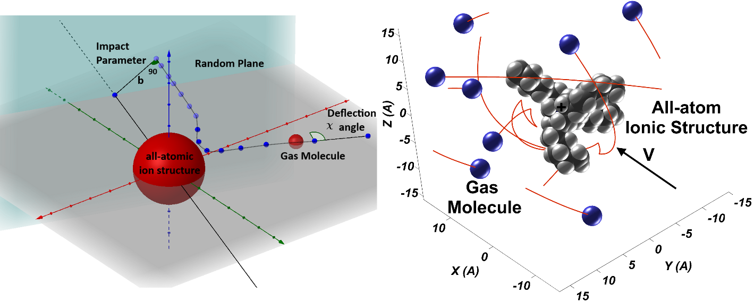
WorkShop Tutorial
What goes into CCS calculations?
Carlos Larriba Andaluz
ASMS Sanibel Conference, January 26th 2018
St. Petersburg, FL

Slide 2
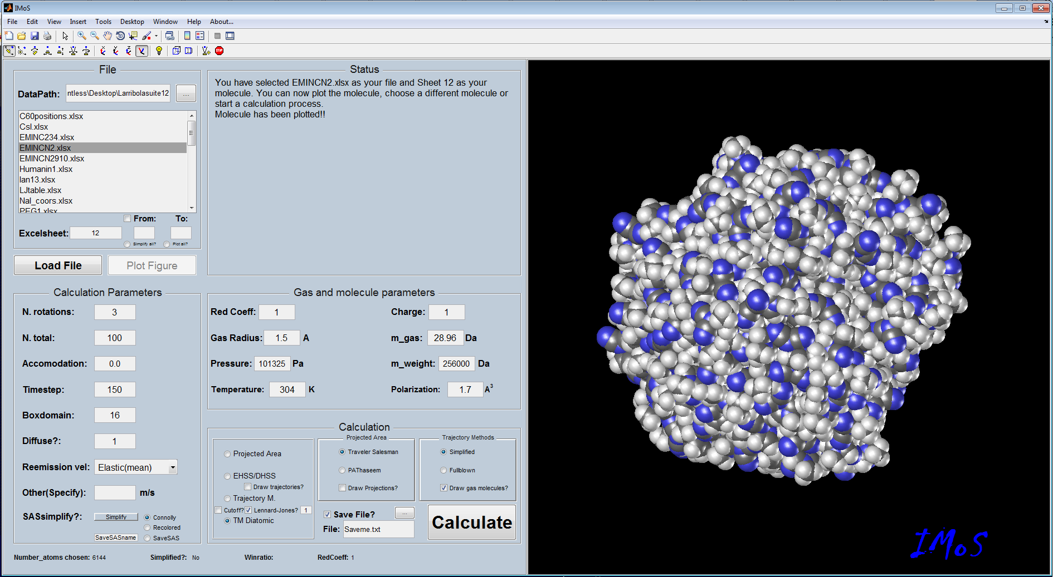
Calculation Methods with Energy Accom.: IMoS
“I”on “Mo”bility “S”pectrometry Software Package

Slide 3
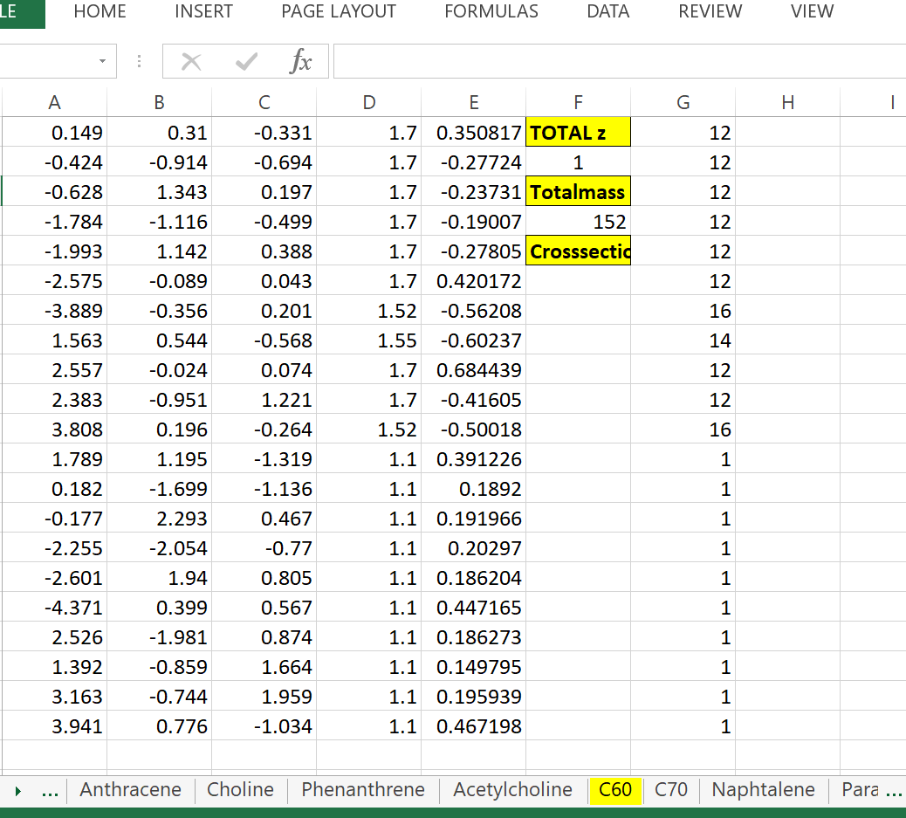
What goes into CCS calculations?
Input
  File may be .mfj (MOBCAL) or .mfj, .pdb, .xlsx, … (IMoS)
  Structure (Taken from DFT, MD, …)
  It may contain partial charges or a centered charge
VdW radii
Atom label
X, Y and Z Coord
P. Charge

Slide 4
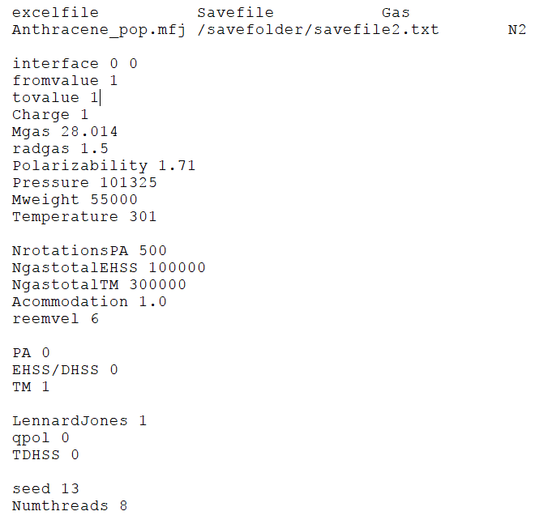
What goes into CCS calculations?
Control File
  Mobcal.run or IMoS.cla
Input File
Output File
Gas (L-J table)
Excel sheets to calculate (excel files)
Gas & Ion Parameters
Mobility Calculation Parameters
Calculation Methods
Trajectory Method Options
Random Seed and Number of Threads

Slide 5
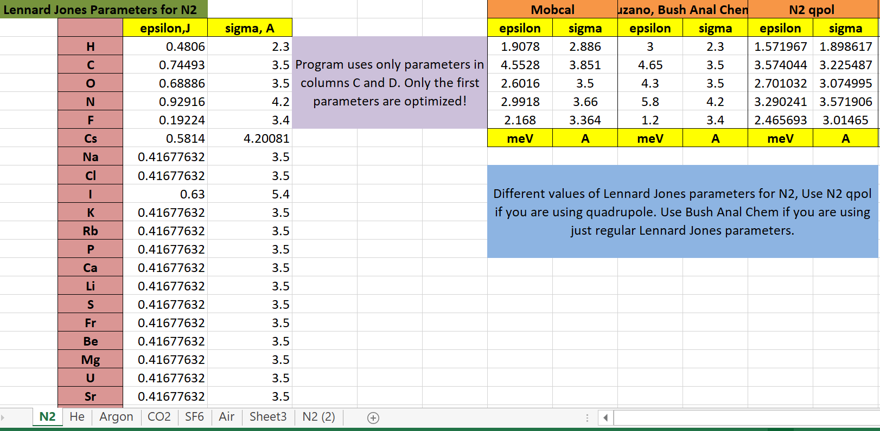
What goes into CCS calculations?
Lennard Jones File
  It contains the L-J parameters for your gas-element pair
New Optimized L-J for N₂
No need for ion-quad potential

Slide 6
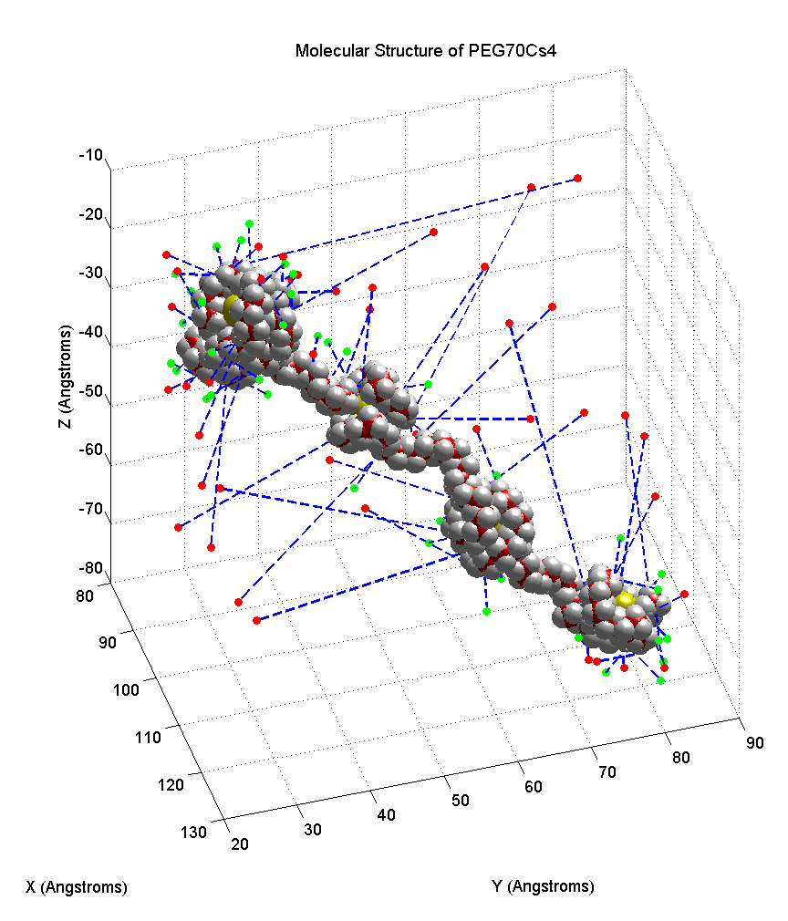
What goes into CCS calculations?
Parallelized Calculations that can be performed on IMoS:
Projected Area Algorithm:
Random orientations.
  Monte Carlo Simulations (PAMC)
  Perimeter Simulations Traveler Salesman (PATSA)
EHSS/DHSS:
Random orientations as well as 3 perpendicular directions.
  Specular Elastic (EHSS)
  Diffuse Inelastic (DHSS) Accommodation Methods
Trajectory Methods:
4-∞ potentials (TDHSS/TEHSS)
    4-6-12 Lennard Jones-Induced Dipole (TMLJ)
Diatomic: 4-∞ potentials (DTMHSS)
Monoatomic:

Slide 7
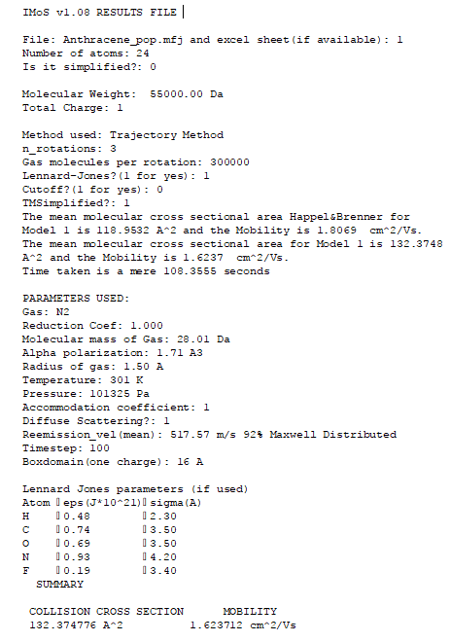
What goes into CCS calculations?
Output File
  File that contains type of calculation, parameters used, CCS and Ion Mobility.

Slide 8

What goes into Trajectory Method Calculations???
MOBCAL SOLVES THE FOLLOWING EQUATION:
ORIENTATION
Momentum Moment of
M-B distribution
Momentum exchange due to angle deflection
Linear component of exponential expansion
Very Daunting at first!
In reality, it is quite simple
Impact Parameter
Why numerical? Deflection Angle difficult to solve Analytically
$$χ=π−2ψ_{0} ; ψ_{0}=\int_{0}^{ψ_{0}}{dψ}=\int_{∞}^{R_{0}}{\frac{dRb}{R^{2}\left[1−\frac{b^{2}}{R^{2}}−\frac{φ\left(R\right)}{\frac{μv^{2}}{2}}\right]}}$$

Slide 9
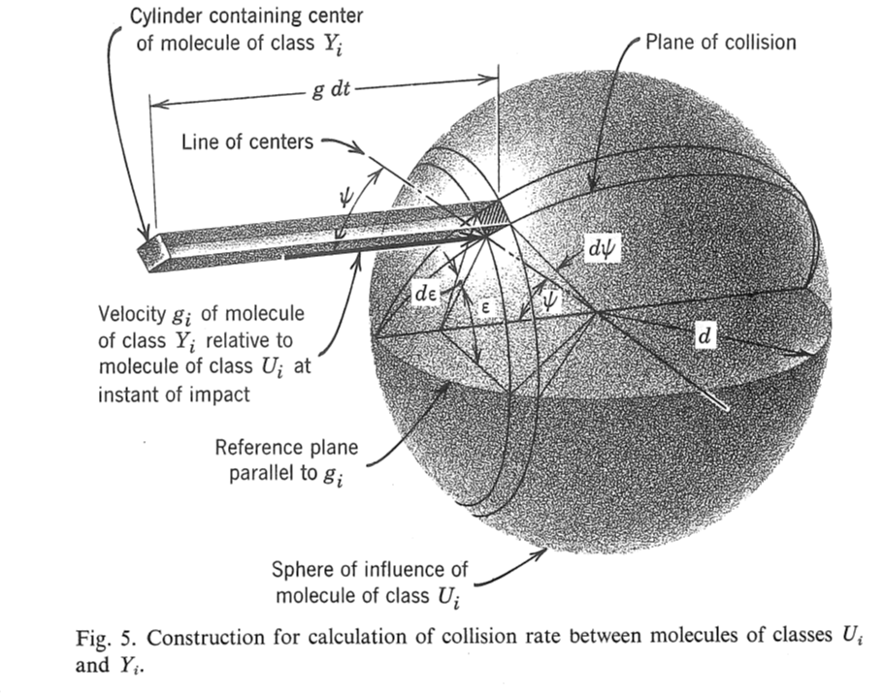

What goes into Trajectory Method Calculations???
In reality, we would like to Calculate the Drag Force on the ion. We do this by calculating the “momentum exchange” per unit time of all the impinging gas molecules on our ion. This has several steps:
First we calculate the number of gas molecules (from M-B distribution) that collide with a particle/ion of velocity V_{u} per unit time (as a flux on an spherical area)
$$nf\left(Y_{i}\right)\left(\vec{g}∙\vec{n}\right)dV_{Y}dV_{u}d^{2}sinψdψdε$$
Green: Flux of particles
Red: Area of particle using 2 angles
Orange: Velocity of ion

Slide 10

What goes into Trajectory Method Calculations???
To calculate the momentum from every collision, one can multiply by the mass and relative velocity of each gas molecule (Momentum per unit time).
But we are actually interested in the change of momentum given to the ion. It is the difference between the incoming momentum per unit time and the remaining momentum per unit time. This is given by the deflection angle.
$$\vec{F}=m\vec{g}\left(1−cosχ\right)\vec{Flux}∙\vec{dA}dV_{u}$$

Slide 11
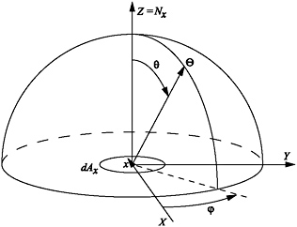
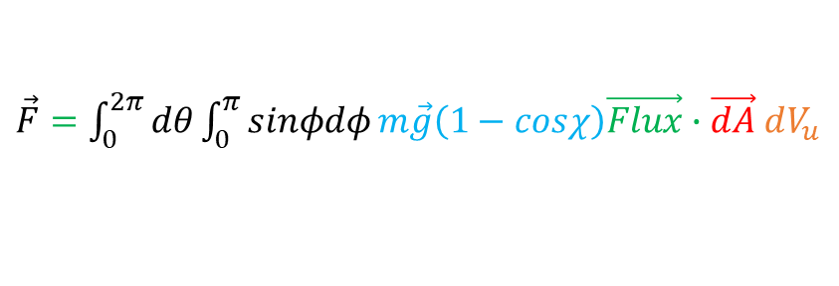
What goes into Trajectory Method Calculations???
The ion is normally not symmetric and thus different orientations lead to different CCS. One can integrate over all possible Orientations to yield and average value.
$\vec{F}=\int_{0}^{2π}{dθ}\int_{0}^{π}{sinφdφ}m\vec{g}\left(1−cosχ\right)\vec{Flux}∙\vec{dA}$ $dV_{u}$

Slide 12
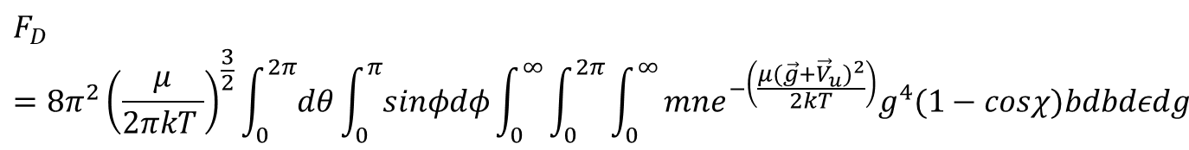
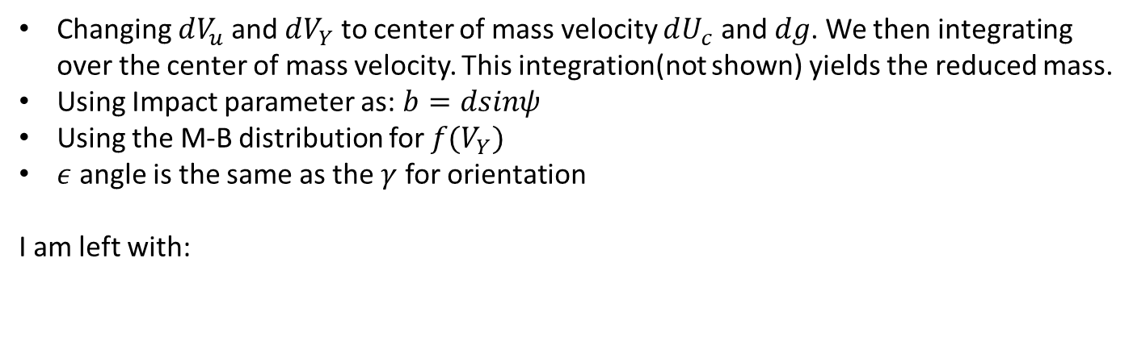
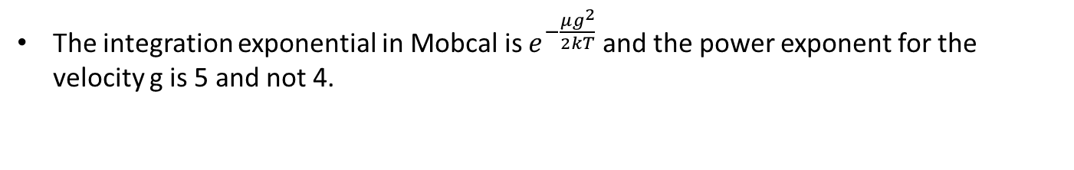
What goes into Trajectory Method Calculations???
Changing $dV_{u}$ and $dV_{Y}$ to center of mass velocity $dU_{c}$ and $dg$. We then integrating over the center of mass velocity. This integration(not shown) yields the reduced mass.
Using Impact parameter as: $b=dsinψ$
Using the M-B distribution for $f(V_{Y})$
$ε$ angle is the same as the $γ$ for orientation
I am left with:
It is different from Mobcal’s Equation!! Why?
The integration exponential in Mobcal is $e^{−\frac{μg^{2}}{2kT}}$ and the power exponent for the velocity g is 5 and not 4.

Slide 13


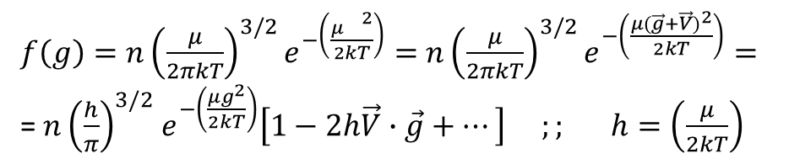
What goes into Trajectory Method Calculations???
The reason is a linearization of the exponential equation:
$f\left(g\right)=n{\left(\frac{μ}{2πkT}\right)}^{3/2}e^{−\left(\frac{μ{}^{2}}{2kT}\right)}=$ $n{\left(\frac{μ}{2πkT}\right)}^{3/2}e^{−\left(\frac{μ{(\vec{g}+\vec{V})}^{2}}{2kT}\right)}=$
= $n{\left(\frac{h}{π}\right)}^{3/2}$ $e^{−\left(\frac{μg^{2}}{2kT}\right)}\left[1−2h\vec{V}∙\vec{g}+…\right] ;; h=\left(\frac{μ}{2kT}\right)$
It is important to note that the integral over the 1 becomes 0!!
We do not need the value of V anymore to calculate $Ω_{1,1}$
This makes it converge much faster as well (Two orders of magnitude)!!
So that the equation becomes:
$$F_{D}=8π^{2}V{\left(\frac{μ}{2πkT }\right)}^{5/2}\int_{0}^{2π}{dθ}\int_{0}^{π}{sinφdφ}\int_{0}^{∞}{\int_{0}^{2π}{\int_{0}^{∞}{mne^{−\left(\frac{μg^{2}}{2kT}\right)}g^{5}\left(1−cosχ\right)2bdbdεdg}}}$$
$$F_{D}=\frac{8}{3π}Vμn{\left(\frac{2πkT}{μ }\right)}^{1/2}Ω_{\left(1,1\right)}$$

Slide 14
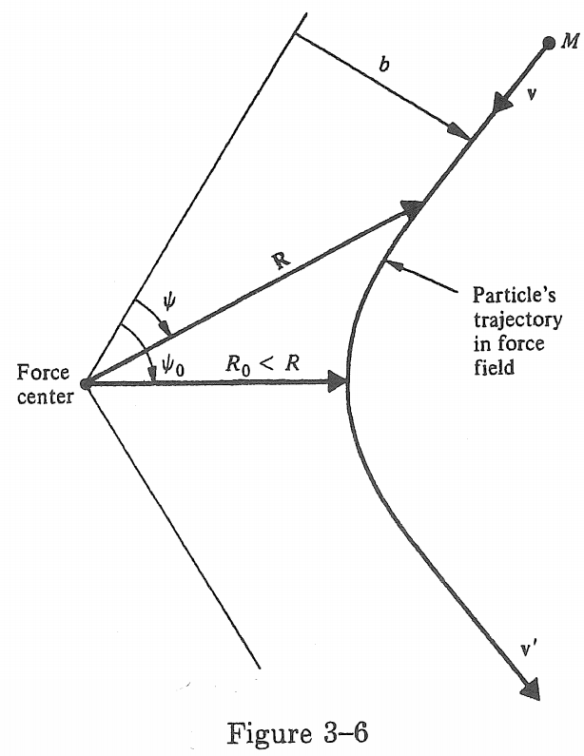
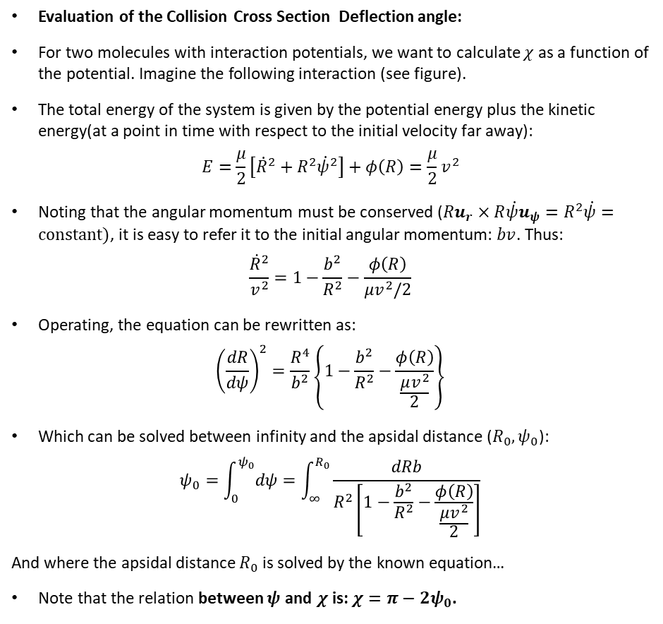
What goes into Trajectory Method Calculations???
Evaluation of the Collision Cross Section Deflection angle:
For two molecules with interaction potentials, we want to calculate $χ$ as a function of the potential. Imagine the following interaction (see figure).
The total energy of the system is given by the potential energy plus the kinetic energy(at a point in time with respect to the initial velocity far away):
$$E=\frac{μ}{2}\left[{\dot{R}}^{2}+R^{2}{\dot{ψ}}^{2}\right]+φ\left(R\right)=\frac{μ}{2}v^{2}$$
Noting that the angular momentum must be conserved ($Ru_{r}×R\dot{ψ}u_{ψ}=R^{2}\dot{ψ}=constant)$, it is easy to refer it to the initial angular momentum: $bv$. Thus:
$$\frac{{\dot{R}}^{2}}{v^{2}}=1−\frac{b^{2}}{R^{2}}−\frac{φ\left(R\right)}{μv^{2}/2}$$
Operating, the equation can be rewritten as:
$${\left(\frac{dR}{dψ}\right)}^{2}=\frac{R^{4}}{b^{2}}\left\{1−\frac{b^{2}}{R^{2}}−\frac{φ\left(R\right)}{\frac{μv^{2}}{2}}\right\}$$
Which can be solved between infinity and the apsidal distance ($R_{0},ψ_{0}$):
$$ψ_{0}=\int_{0}^{ψ_{0}}{dψ}=\int_{∞}^{R_{0}}{\frac{dRb}{R^{2}\left[1−\frac{b^{2}}{R^{2}}−\frac{φ\left(R\right)}{\frac{μv^{2}}{2}}\right]}}$$
And where the apsidal distance $R_{0}$ is solved by the known equation…
Note that the relation between $ψ$ and $χ$ is: $χ=π−2ψ_{0}$.
Very complex!! Needs to be done Numerically

Slide 15
Numerical Calculation of the Angular Deflection for an ion-induced dipole potential ~r⁻⁴
Deflection angle as a function of apsidal potential for Grazing Molecules

Slide 16
What goes into Trajectory Method Calculations???
LIMITATIONS OF THE TRAJECTORY METHOD:
Does not work for high Velocities of the ion. The reason is the linearization used in the equations.
Does not work with preferred orientations. The reason is that we are assuming all directions are equally probable.
Velocity of ion is assumed constant on average. This is not true in general.
Numerical assumptions have to be used to calculate the deflection:
  All atoms are fixed in space.
  Not all potentials are always taken into account (ion quadrupole).
  Collisions might be specular and elastic or diffuse and inelastic.
  If you want a more accurate calculations, it requires more time.
  Difficulty understanding how the relative velocities affect the deflection angles.

